Slide 1
NetSlices: Scalable Multi-Core Packet Processing in User-Space
Tudor Marian, Ki Suh Lee, Hakim Weatherspoon
Cornell University
Presented by Ki Suh Lee

Slide 2



Packet Processors
Essential for evolving networks
  Sophisticated functionality
  Complex performance enhancement protocols

Slide 3
Packet Processors
Essential for evolving networks
  Sophisticated functionality
  Complex performance enhancement protocols
Challenges: High-performance and flexibility
  10GE and beyond
  Tradeoffs

Slide 4
Software Packet Processors
Low-level (kernel) vs. High-level (userspace)
Parallelism in userspace: Four major difficulties
  Overheads & Contention
  Kernel network stack
  Lack of control over hardware resources
  Portability

Slide 5


Overheads & Contention
NIC
Cache coherence
Memory Wall
Slow cores vs. Fast NICs
CPU
Memory
Memory

Slide 6
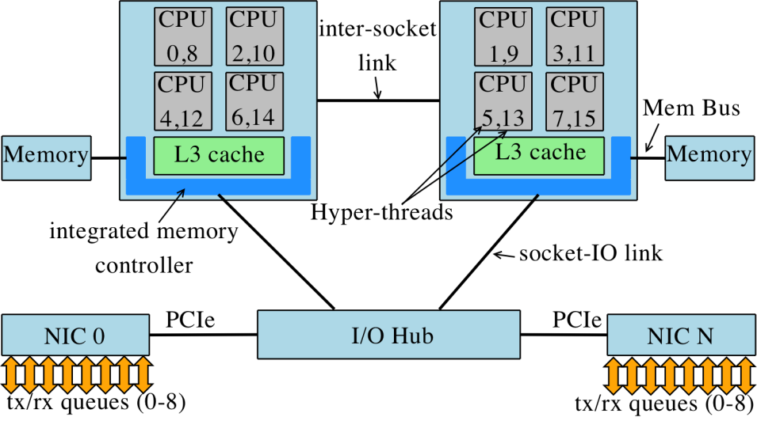
Kernel network stack & HW control
Raw socket: all traffic from all NICs to user-space
Too general, hence complex network stack
Hardware and software are loosely coupled
Applications have no control over resources
Application
Application
Network
Stack
Network
Stack
Network
Stack
Application
Network
Stack
Application
Network
Stack
Application
Network
Stack
Network
Stack
Application
Network
Stack
Network
Stack
Application
Application
Application
Raw socket
Network
Stack

Slide 7
Portability
Hardware dependencies
Kernel and device driver modifications
  Zero-copy
  Kernel bypass

Slide 8
Outline
Difficulties in building packet processors
NetSlice
Evaluation
Discussions
Conclusion

Slide 9

NetSlice
Give power to the application
  Overheads & Contention
  Lack of control over hardware resources
    Spatial partitioning exploiting NUMA architecture
  Kernel network stack
    Streamlined path for packets
  Portability
    No zero-copy, kernel & device driver modifications

Slide 10



NetSlice Spatial Partitioning
Independent (parallel) execution contexts
  Split each Network Interface Controller (NIC)
    One NIC queue per NIC per context
  Group and split the CPU cores
  Implicit resources (bus and memory bandwidth)
Temporal partitioning
(time-sharing)
Spatial partitioning
(exclusive-access)

Slide 11

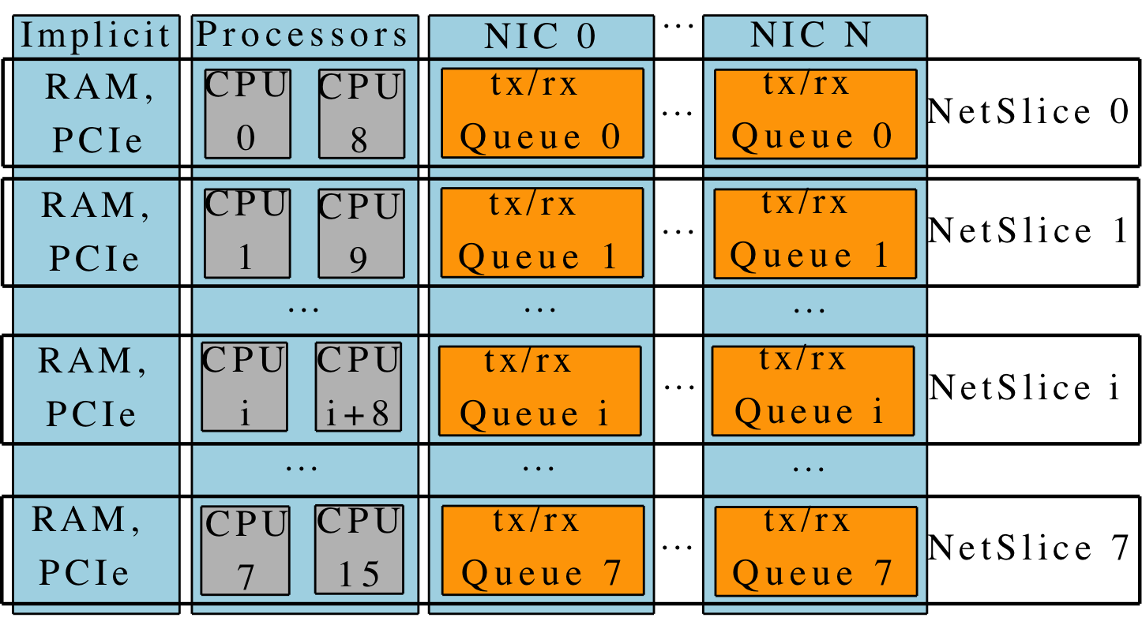
NetSlice Spatial Partitioning Example
2x quad core Intel Xeon X5570 (Nehalem)
  Two simultaneous hyperthreads – OS sees 16 CPUs
  Non Uniform Memory Access (NUMA)
    QuickPath point-to-point interconnect
  Shared L3 cache

Slide 12
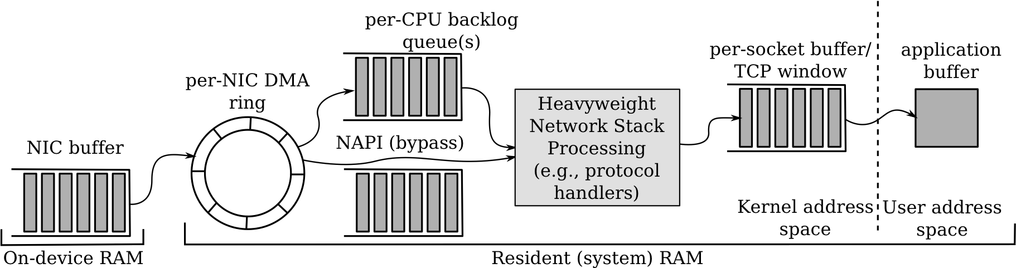
Streamlined Path for Packets
Inefficient conventional network stack
  One network stack “to rule them all”
  Performs too many memory accesses
  Pollutes cache, context switches, synchronization, system calls, blocking API
Heavyweight
Network Stack

Slide 13
Portability
No zero-copy
  Tradeoffs between portability and performance
  NetSlices achieves both
No hardware dependency
A run-time loadable kernel module

Slide 14
NetSlice API
Expresses fine-grained hardware control
Flexible: based on ioctl
Easy: open, read, write, close
1: #include "netslice.h"
2:
3: structnetslice_rw_multi {
4: int flags;
5: } rw_multi;
6:
7: structnetslice_cpu_mask {
8: cpu_set_tk_peer, u_peer;
9: } mask;
10:
11: fd = open("/dev/netslice-1", O_RDWR);
12:
13: rw_multi.flags = MULTI_READ | MULTI_WRITE;
14: ioctl(fd, NETSLICE_RW_MULTI_SET, &rw_multi);
15: ioctl(fd, NETSLICE_CPUMASK_GET, &mask);
16: sched_setaffinity(getpid(), sizeof(cpu_set_t),
17: &mask.u_peer);
18
19: for (;;) {
20: ssize_tcnt, wcnt = 0;
21: if ((cnt = read(fd, iov, IOVS)) < 0)
22: EXIT_FAIL_MSG("read");
23:
24: for (i = 0; i<cnt; i++)
25: /* iov_rlen marks bytes read */
26: scan_pkg(iov[i].iov_base, iov[i].iov_rlen);
27: do {
28: size_twr_iovs;
29: /* write iov_rlen bytes */
30: wr_iovs = write(fd, &iov[wcnt], cnt-wcnt);
31: if (wr_iovs< 0)
32: EXIT_FAIL_MSG("write");
33: wcnt += wr_iovs;
34: } while (wcnt<cnt);
35: }

Slide 15
NetSlice Evaluation
Compare against state-of-the-art
  RouteBricks in-kernel, Click & pcap-mmap user-space
Additional baseline scenario
  All traffic through single NIC queue (receive-livelock)
What is the basic forwarding performance?
  How efficient is the streamlining of one NetSlice?
How is NetSlice scaling with the number of cores?

Slide 16
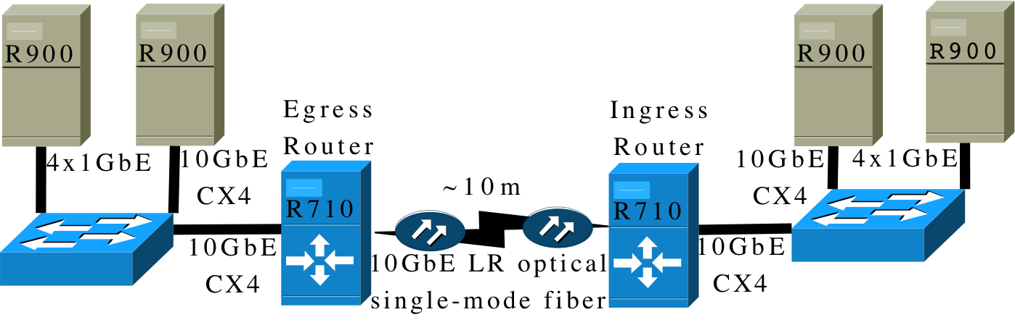

Experimental Setup
R710 packet processors
  dual socket quad core 2.93GHz Xeon X5570 (Nehalem)
  8MB of shared L3 cache and 12GB of RAM
    6GB connected to each of the two CPU sockets
    Two Myri-10G NICs
R900 client end-hosts
  four socket 2.40GHz Xeon E7330 (Penryn)
  6MB of L2 cache and 32GB of RAM

Slide 17
Simple Packet Routing
End-to-end throughput, MTU (1500 byte) packets
74% of
kernel
1/11 of
NetSlice

Slide 18
Linear Scaling with CPUs
IPsec with 128 bit key—typically used by VPN
  AES encryption in Cipher-block Chaining mode

Slide 19
Outline
Difficulties in building packet processors
Netslice
Evaluation
Discussions
Conclusion

Slide 20
Software Packet Processors
Can support 10GE and more at line-speed
  Batching
    Hardware, device driver, cross-domain batching
  Hardware support
    Multi-queue, multi-core, NUMA , GPU
  Removing IRQ overhead
  Removing memory overhead
    Including zero-copy
  Bypassing kernel network stack

Slide 21


Software Packet Processors
 | Batching | Parallelism | Zero-Copy | Portability | Domain
Raw socket |  |  |  |  | User
RouteBricks |  |  |  |  | Kernel
PacketShader |  |  |  |  | User
PF_RING |  |  |  |  | User
netmap |  |  |  |  | User
Kernel-bypass |  |  |  |  | User
NetSlice |  |  |  |  | User

Slide 22
Software Packet Processors
 | Batching | Multi-queue | Zero-Copy | Portability | Domain
Raw socket |  |  |  |  | User
RouteBricks |  |  |  |  | Kernel
PacketShader |  |  |  |  | User
PF_RING |  |  |  |  | User
netmap |  |  |  |  | User
Kernel-bypass |  |  |  |  | User
NetSlice |  |  |  |  | User

Slide 23
Software Packet Processors
 | Batching | Multi-queue | Zero-Copy | Portability | Domain
Raw socket |  |  |  |  | User
RouteBricks |  |  |  |  | Kernel
PacketShader |  |  |  |  | User
PF_RING |  |  |  |  | User
netmap |  |  |  |  | User
Kernel-bypass |  |  |  |  | User
NetSlice |  |  |  |  | User

Slide 24
Software Packet Processors
 | Batching | Multi-queue | Zero-Copy | Portability | Domain
Raw socket |  |  |  |  | User
RouteBricks |  |  |  |  | Kernel
PacketShader |  |  |  |  | User
PF_RING |  |  |  |  | User
netmap |  |  |  |  | User
Kernel-bypass |  |  |  |  | User
NetSlice |  |  |  |  | User

Slide 25
Software Packet Processors
 | Batching | Parallelism | Zero-Copy | Portability | Domain
Raw socket |  |  |  |  | User
RouteBricks |  |  |  |  | Kernel
PacketShader |  |  |  |  | User
PF_RING |  |  |  |  | User
netmap |  |  |  |  | User
Kernel-bypass |  |  |  |  | User
NetSlice |  |  |  |  | User

Slide 26
Software Packet Processors
 | Batching | Parallelism | Zero-Copy | Portability | Domain
Raw socket |  |  |  |  | User
RouteBricks |  |  |  |  | Kernel
PacketShader |  |  |  |  | User
PF_RING |  |  |  |  | User
netmap |  |  |  |  | User
Kernel-bypass |  |  |  |  | User
NetSlice |  |  |  |  | User
Optimized for RX path only

Slide 27
Software Packet Processors
 | Batching | Parallelism | Zero-Copy | Portability | Domain
Raw socket |  |  |  |  | User
RouteBricks |  |  |  |  | Kernel
PacketShader |  |  |  |  | User
PF_RING |  |  |  |  | User
netmap |  |  |  |  | User
Kernel-bypass |  |  |  |  | User
NetSlice |  |  |  |  | User

Slide 28
Discussions
40G and beyond
  DPI, FEC, DEDUP, …
Deterministic RSS
Small packets

Slide 29
Conclusion
NetSlices: A new abstraction
  OS support to build packet processing applications
  Harness implicit parallelism of modern hardware to scale
  Highly portable
Webpage: http://netslice.cs.cornell.edu

